Slide 1

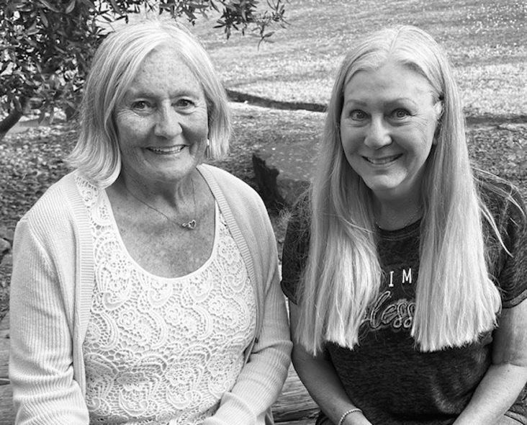
Award Winning Quilts
Quilts by the Sea
July 31-August 1, 2016
Show Chairs:
Cindy McEntee and
Janet Scanlon

Slide 2
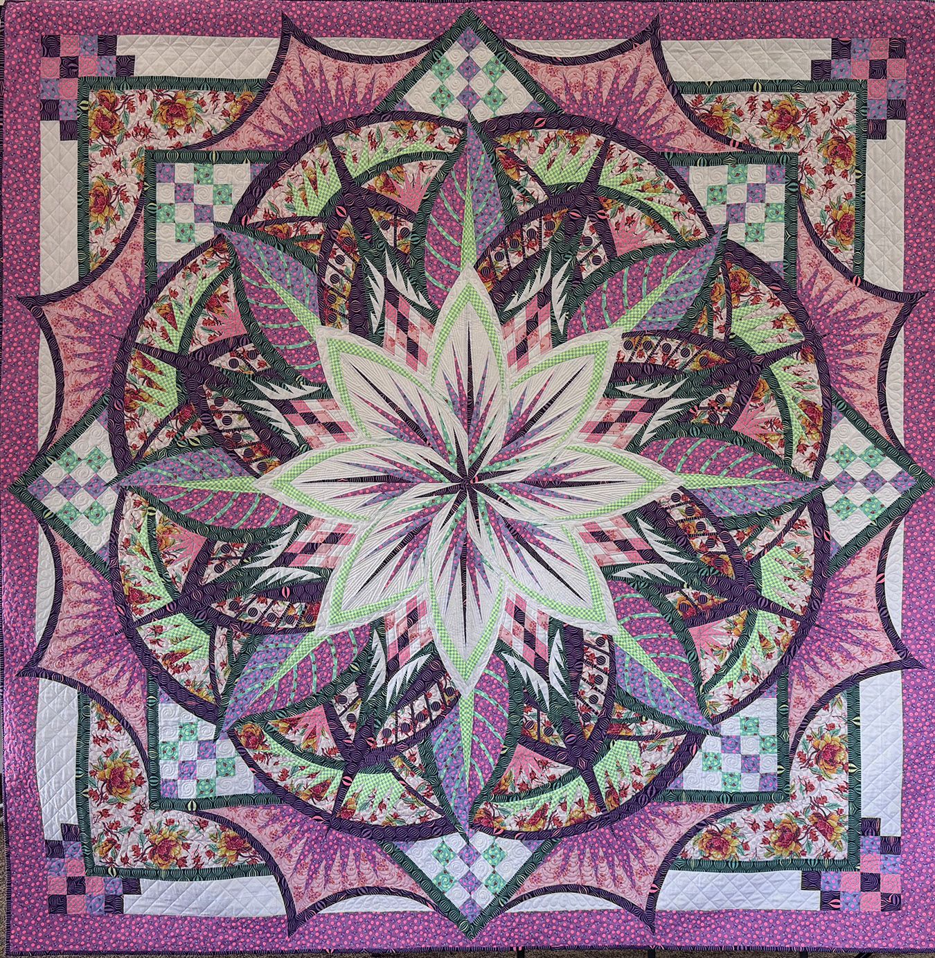
Best of Show - Bed
Tula Pink in Pink
Cindy McEntee

Slide 3
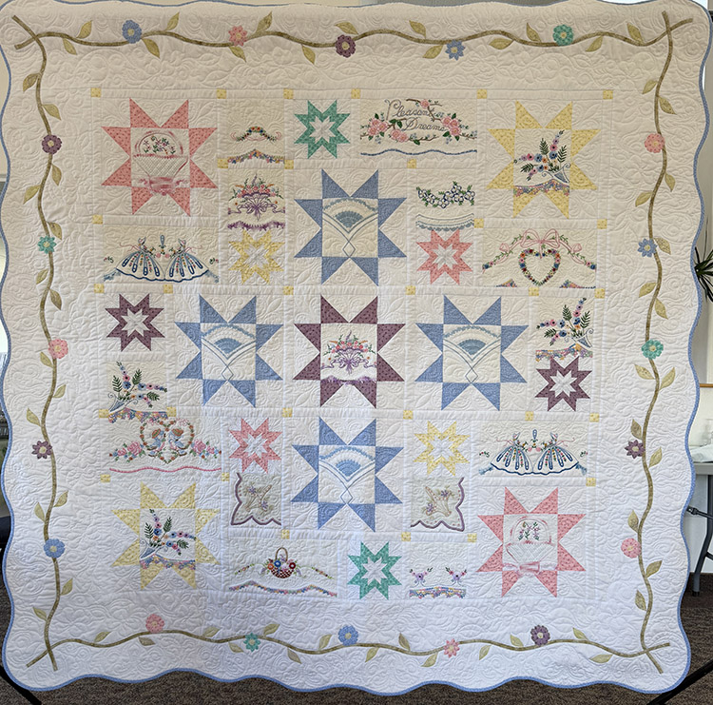
Best of Show - Wall
Generations Sewn Together
Jane Szabo

Slide 4
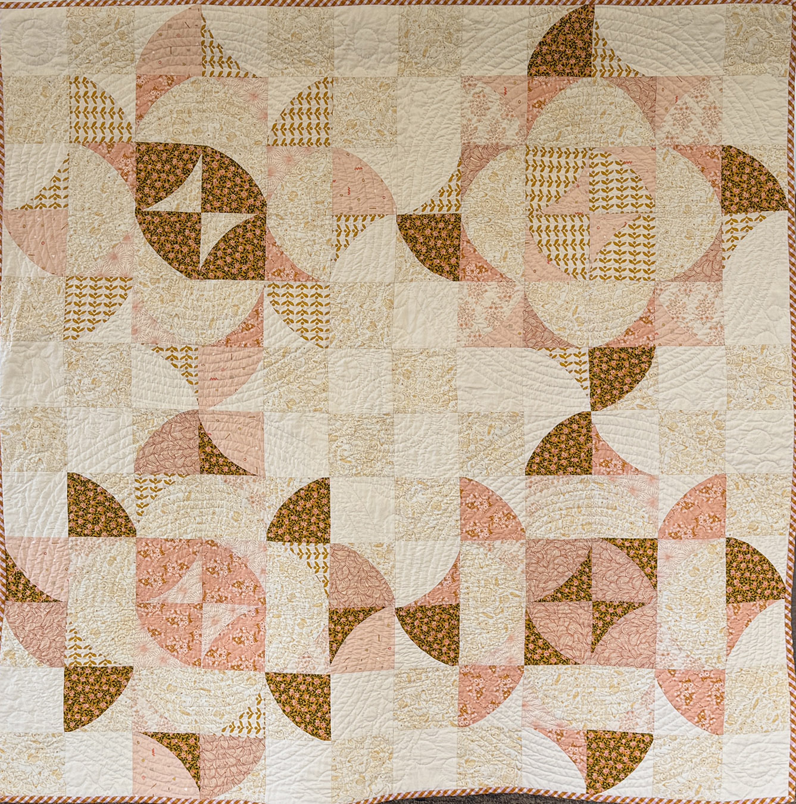
Golden Needle
Hand Quilting
Tiny Bubbles
Paula Brown

Slide 5
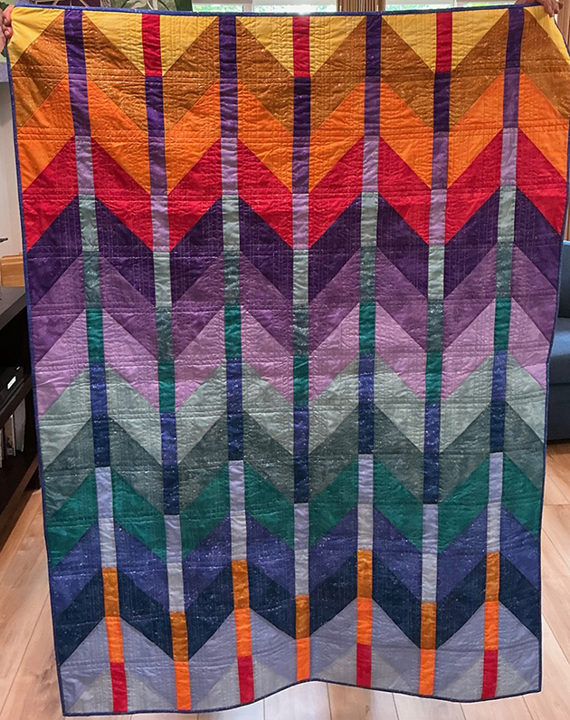
Judge’s Choice
Catching the Light
Jean Amundson

Slide 6
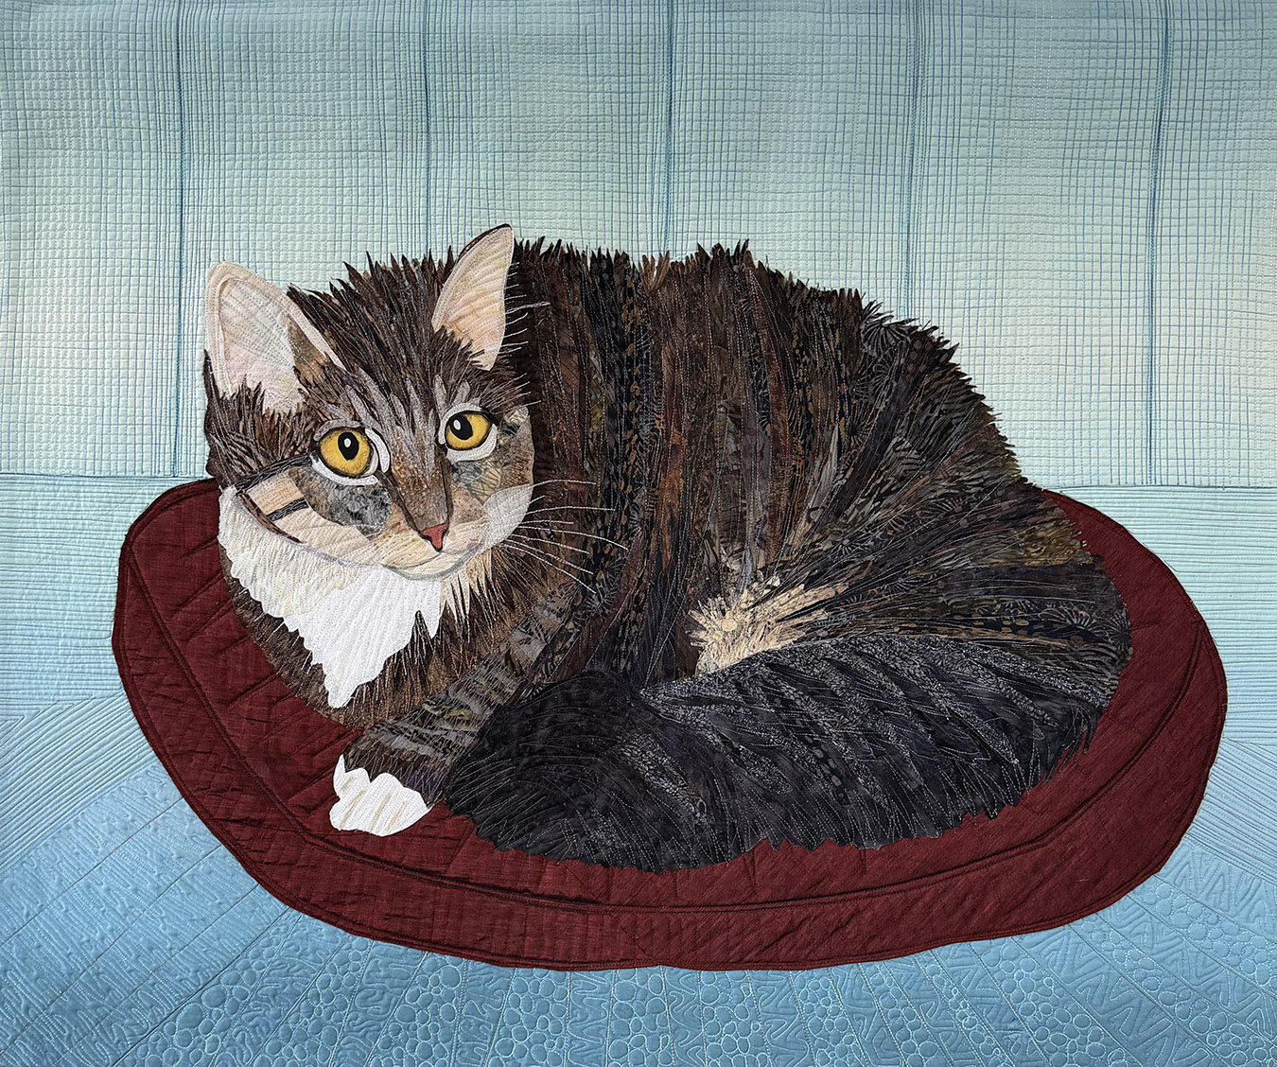
ART – Wall 1st Place
Sadie on Silk
Gloria Zirges

Slide 7
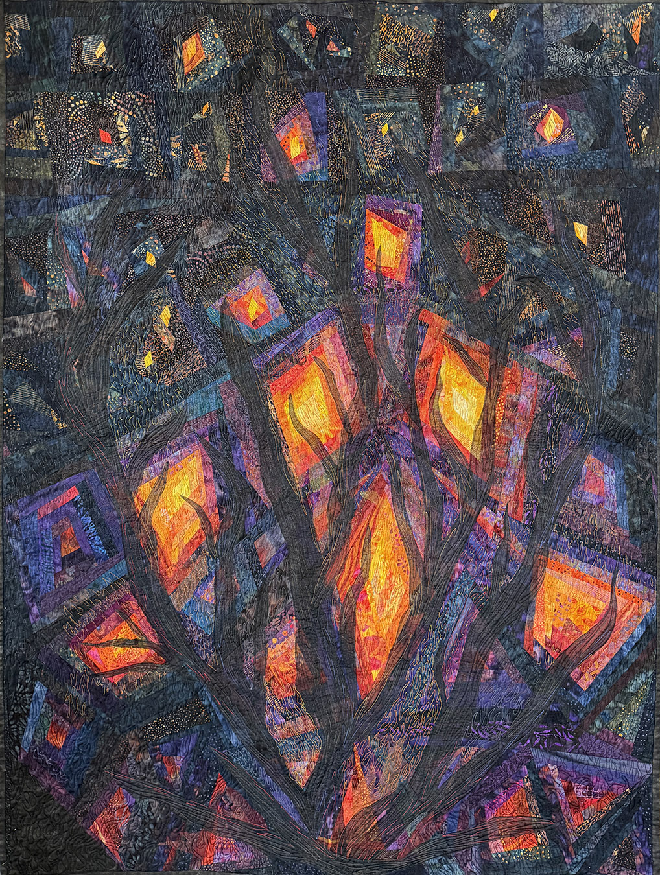
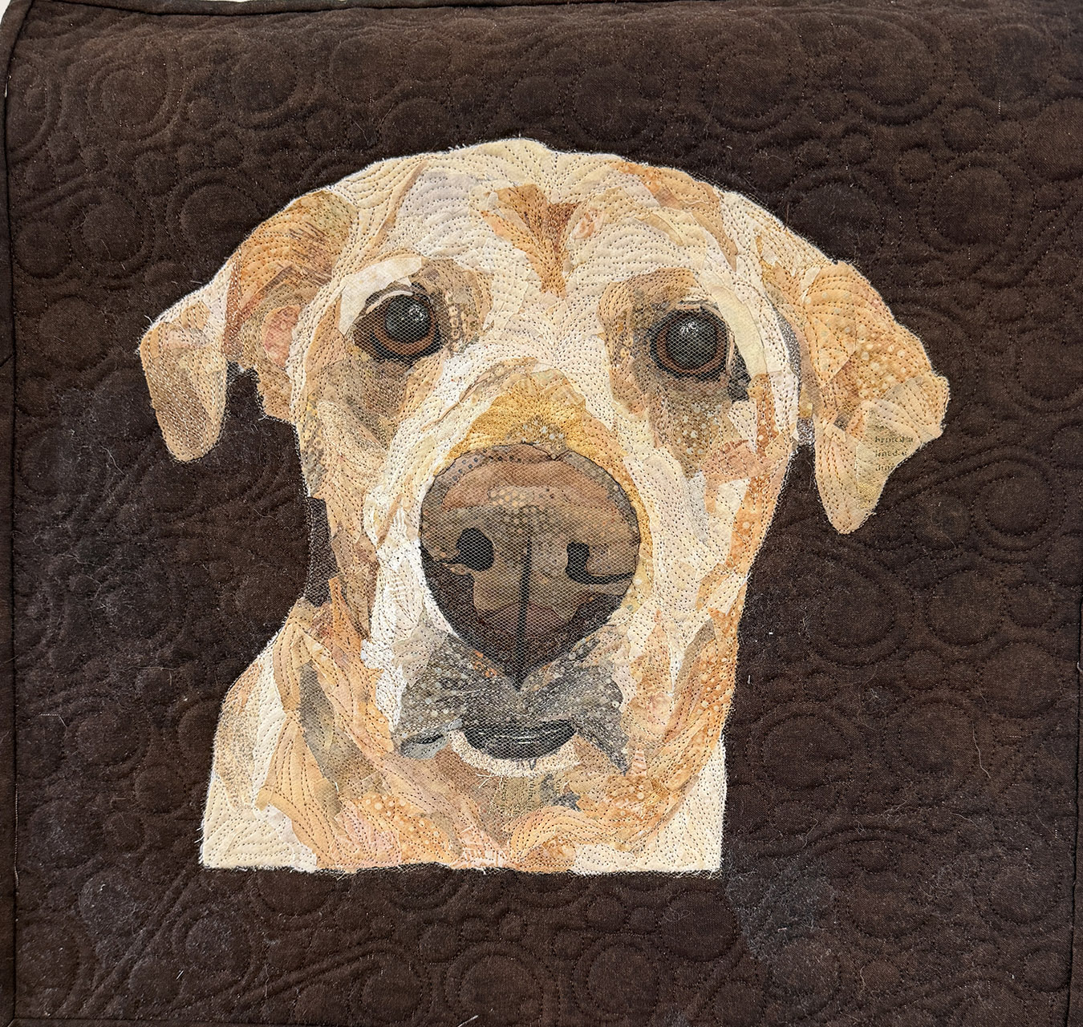
ART – Wall 2nd
ART – Wall 3rd
Embers, Flames, Sparks
Gloria Zirges
Annabelle
Carrie Townsend

Slide 8
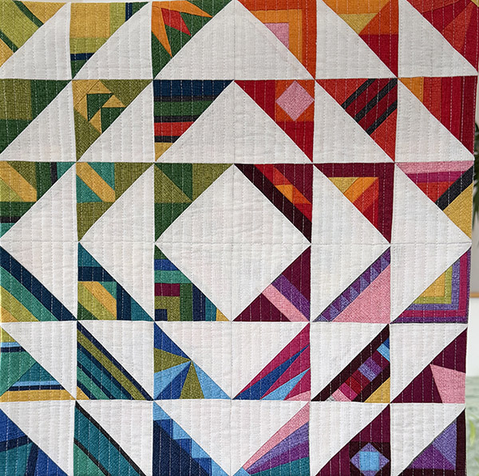
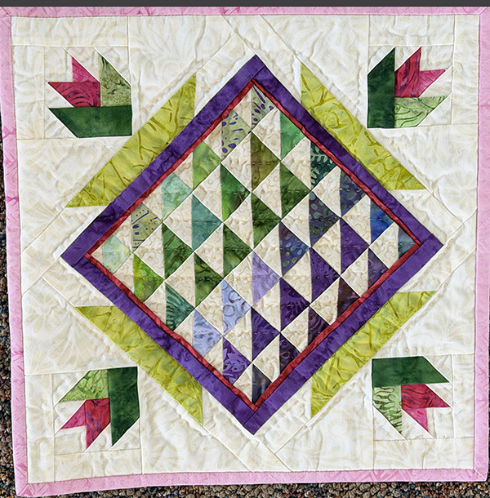
MINIATURE – Wall-1st
Modern Mini
Jane Szabo
MINIATURE – Wall-2nd
Remains of the Day
Judy McCoy

Slide 9
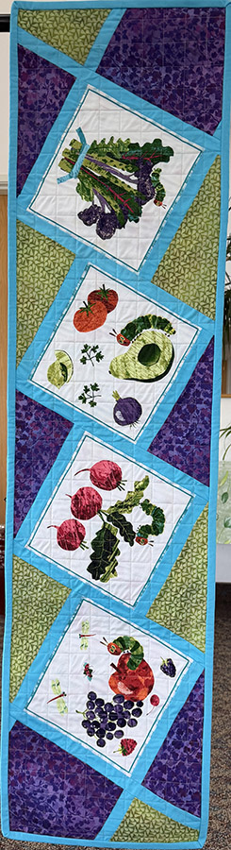
Home Accessories 1st
The Hungry Caterpillar’s Picnic
Risa Northway

Slide 10
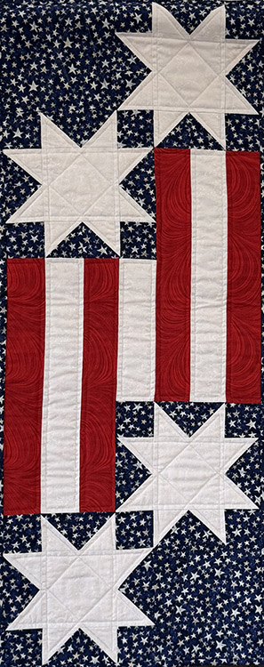
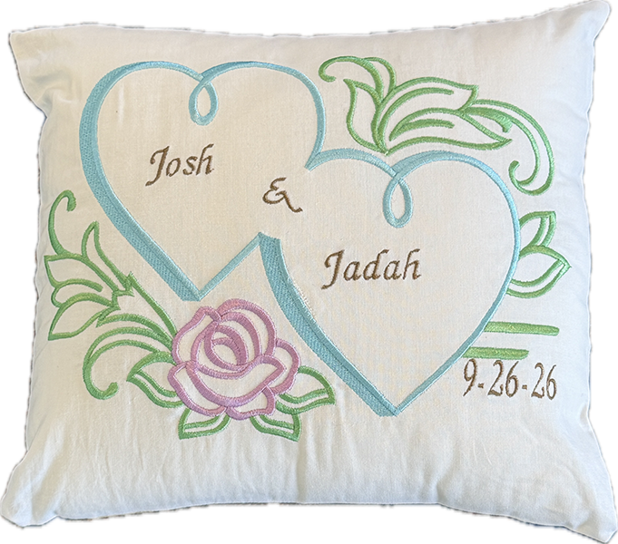
Home Accessories 2nd
Home Accessories 3rd
Stars and Stripes
Darcy de la Rosa
Wedding Pillow
Diane Tillotson

Slide 11
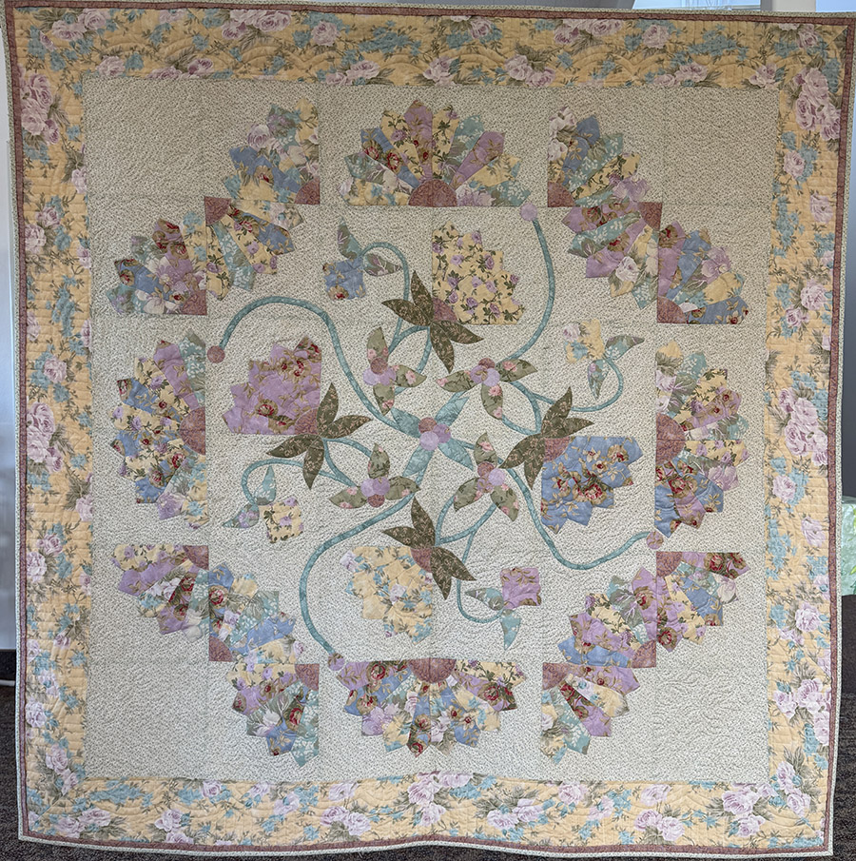
Pieced Solo –Wall 1st
“Remembering”
Toni Brodie

Slide 12
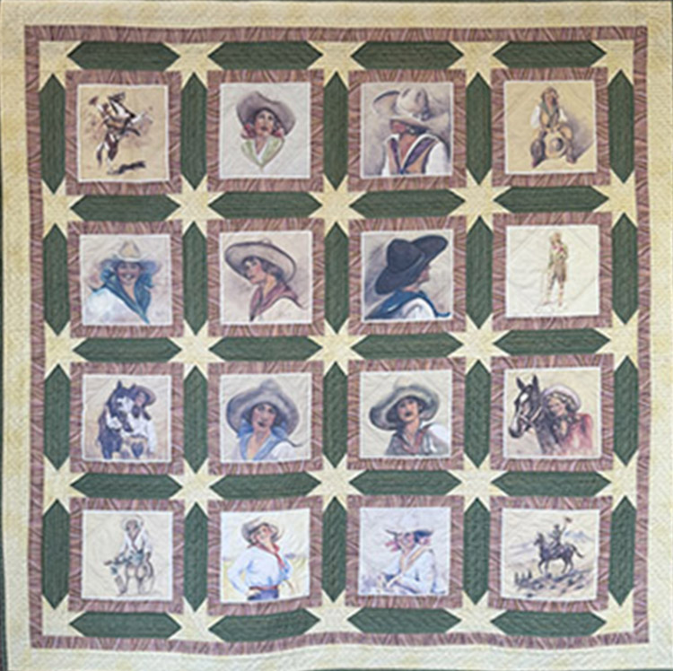
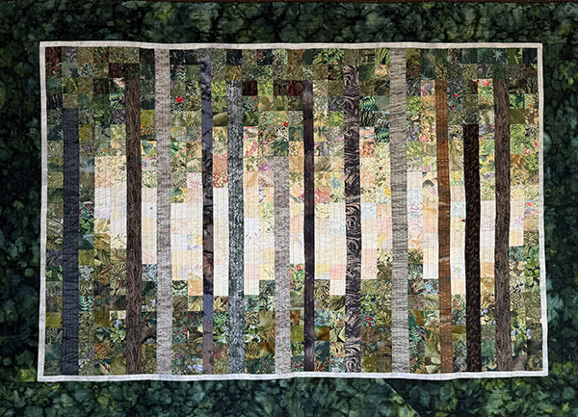
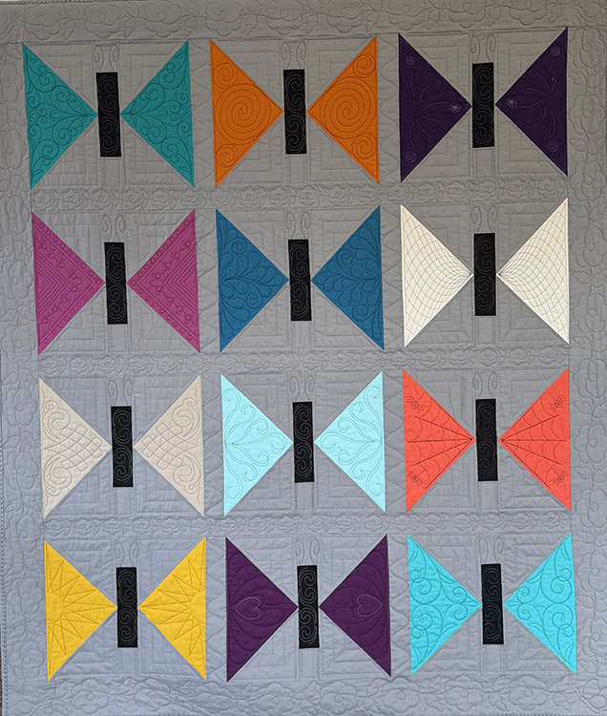
Pieced Solo – Wall 2nd
Pieced Solo – Wall 3rd
Trees
Paulette Stenberg
“Rodeo Royalty”
Toni Brodie
Pieced Solo – Wall HM
Mariposa Garden
Terri Mills

Slide 13
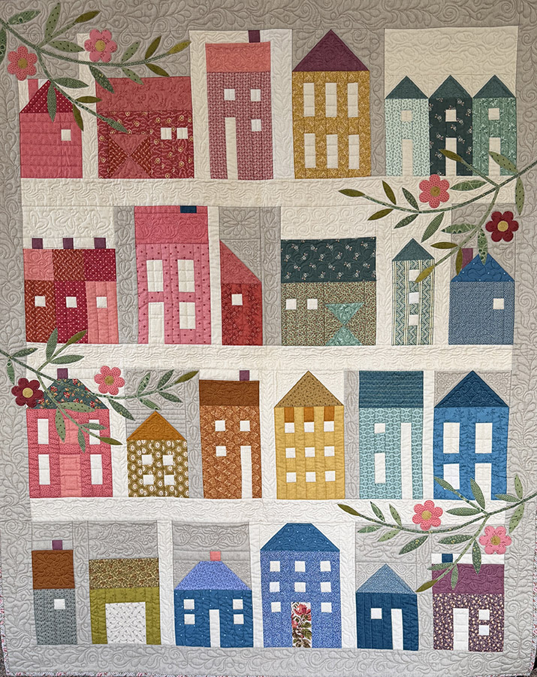
Pieced Ensemble – Wall 1st
July Summer Village
Fran Whited

Slide 14
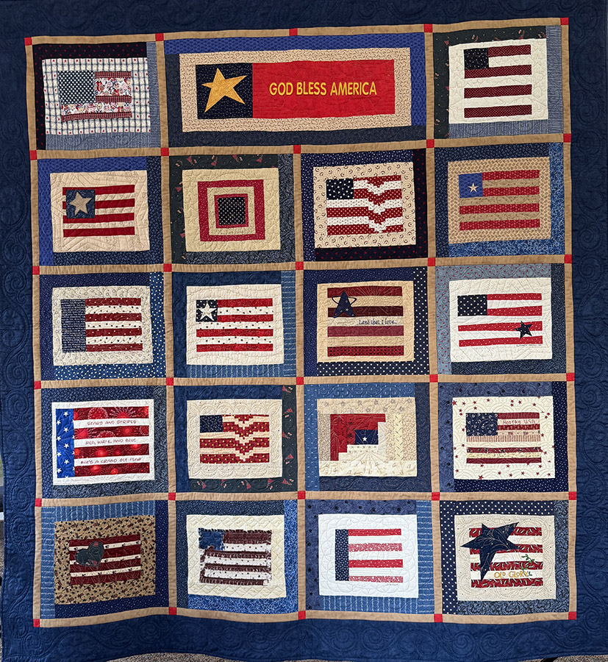
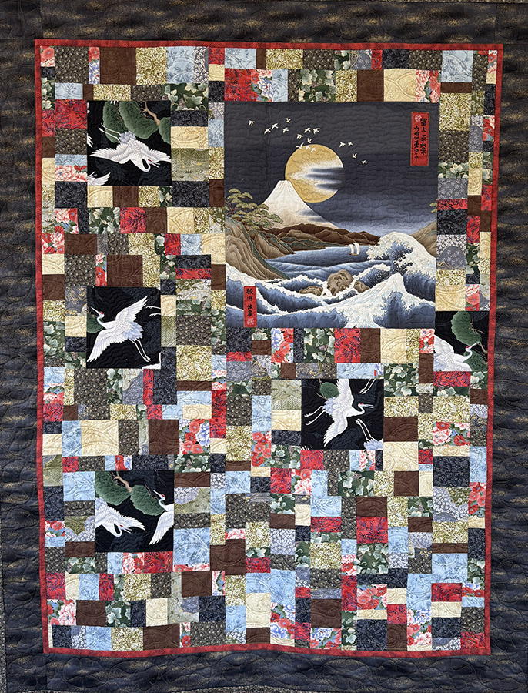
Pieced Ensemble – Wall 2nd
Pieced Ensemble – Wall 3rd
God Bless America
Elizabeth Morrill
Reflections on Serenity
Renee Dickerson

Slide 15
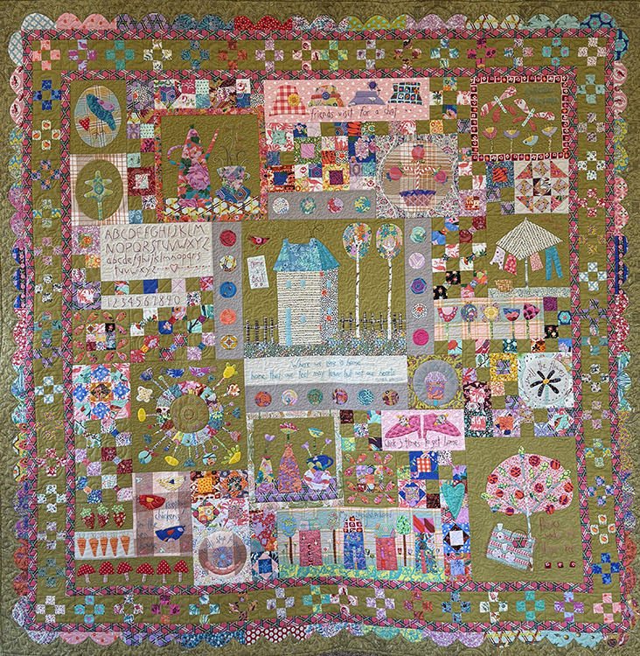
Appliqued– Wall 1st
Where We Love is Home
Ruth Hutmacher

Slide 16
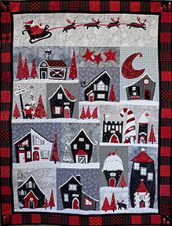
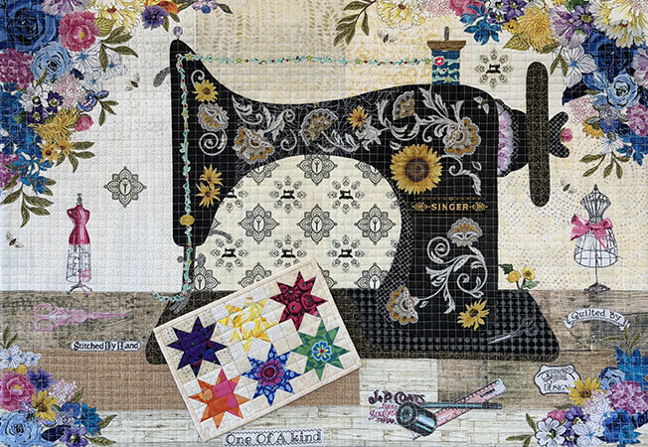
Appliqued – Wall 2nd
Appliqued – Wall 3rd
Welcome to the North Pole
Nancy Payne
Singer in Bloom
Jane Szabo

Slide 17
Other Technique – Wall 1st
Generations Sewn Together
Jane Szabo

Slide 18
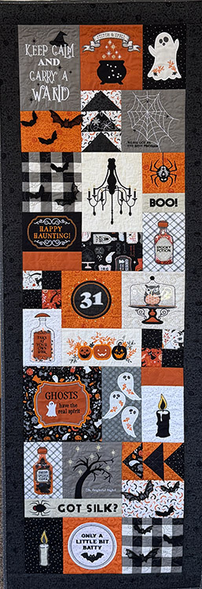
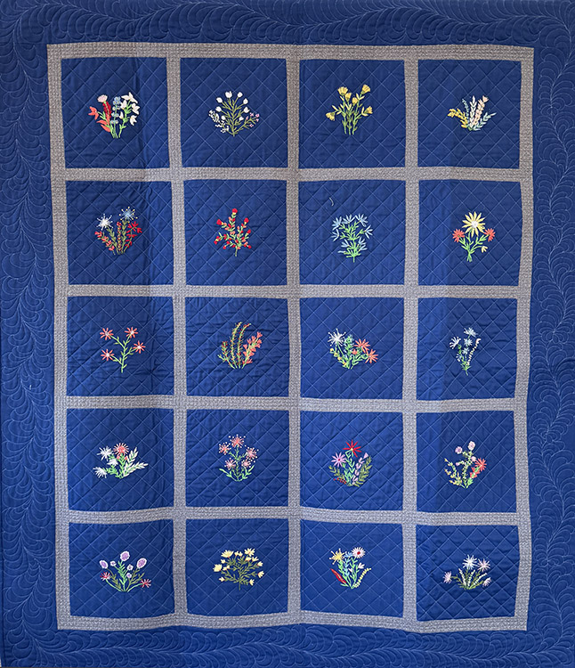
Other Technique – Wall 2nd
Other Technique – Wall 3rd
Happy Haunting
Sheri Stewart
Gram Gram’s Flower Garden
Cheryl Kramer

Slide 19
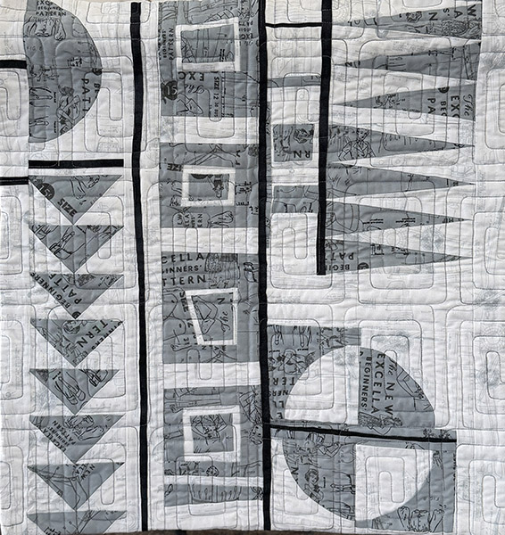
Modern – 1st
Shades of Gray
Lorna Myers

Slide 20
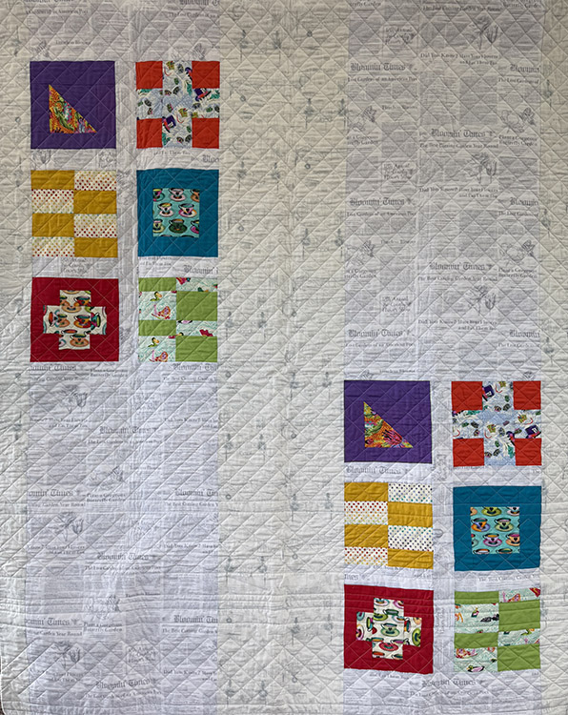
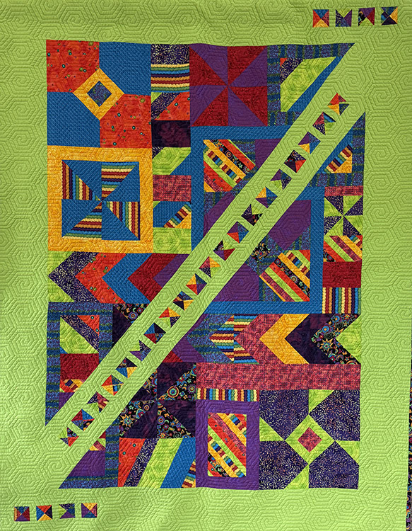
Modern - 2nd
Modern -3rd
6 Blocks
Lorna Myers
Colors of an Oregon Spring
Renee Dickerson

Slide 21
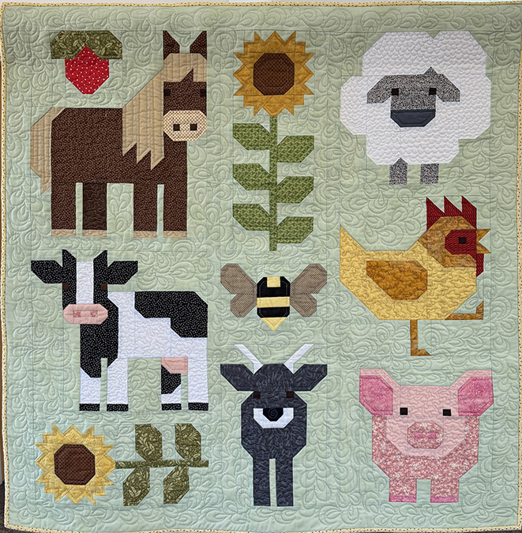
Children’s Theme -1st
E-I-E-I-O
Velma Freudenthal

Slide 22
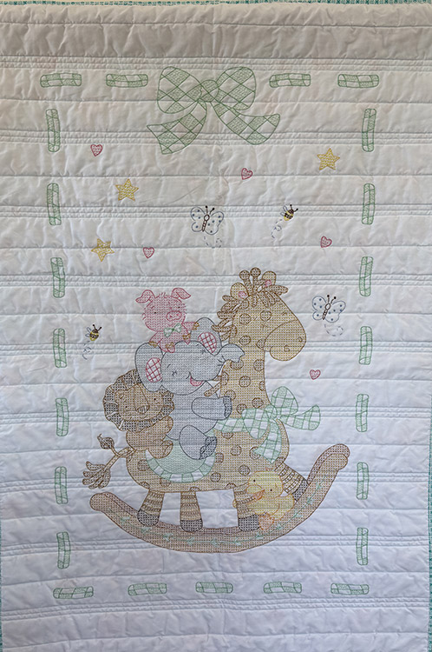
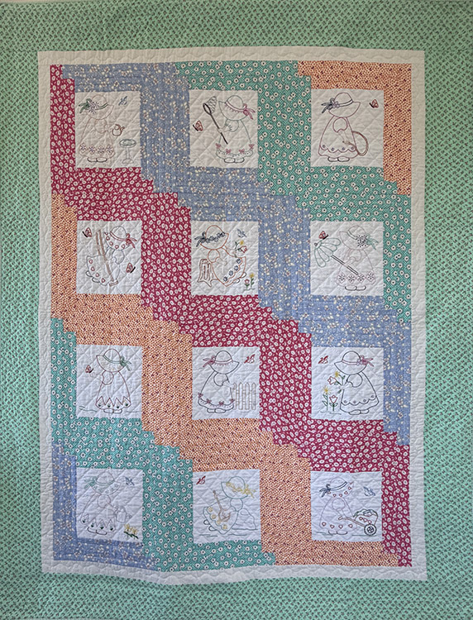
Children’s Theme - 2nd
Children’s Theme - 3rd
Rocking Giraffe
Paulette Stenberg
Sunbonnet Sue
Paulette Stenberg

Slide 23
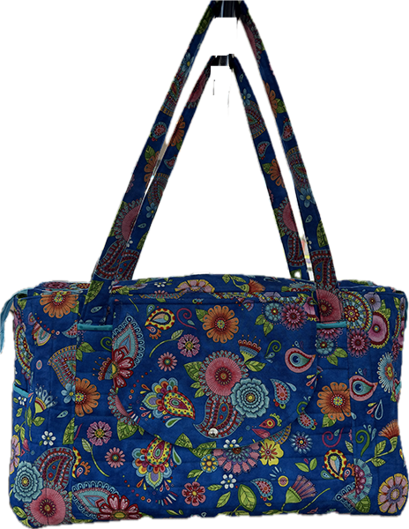
Wearables -1st
Overnight Bag
Velma Freudenthal

Slide 24
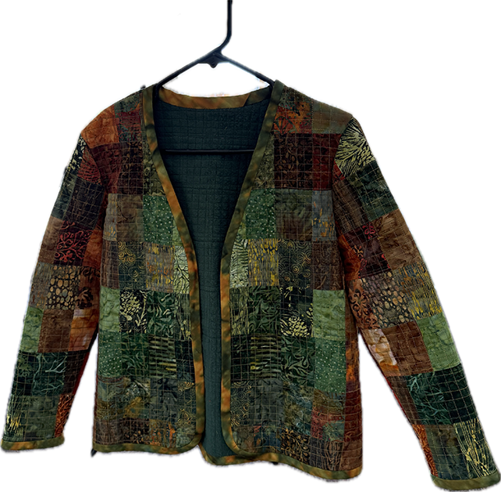
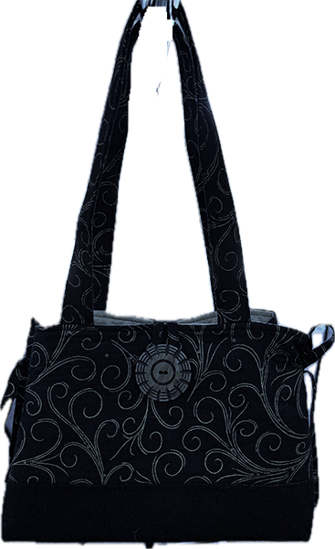
Wearables- 2nd
Wearables- 3rd
Autumn is Coming
Darcy de la Rosa
Bow Tucks Hand Bag
Toni Brodie

Slide 25
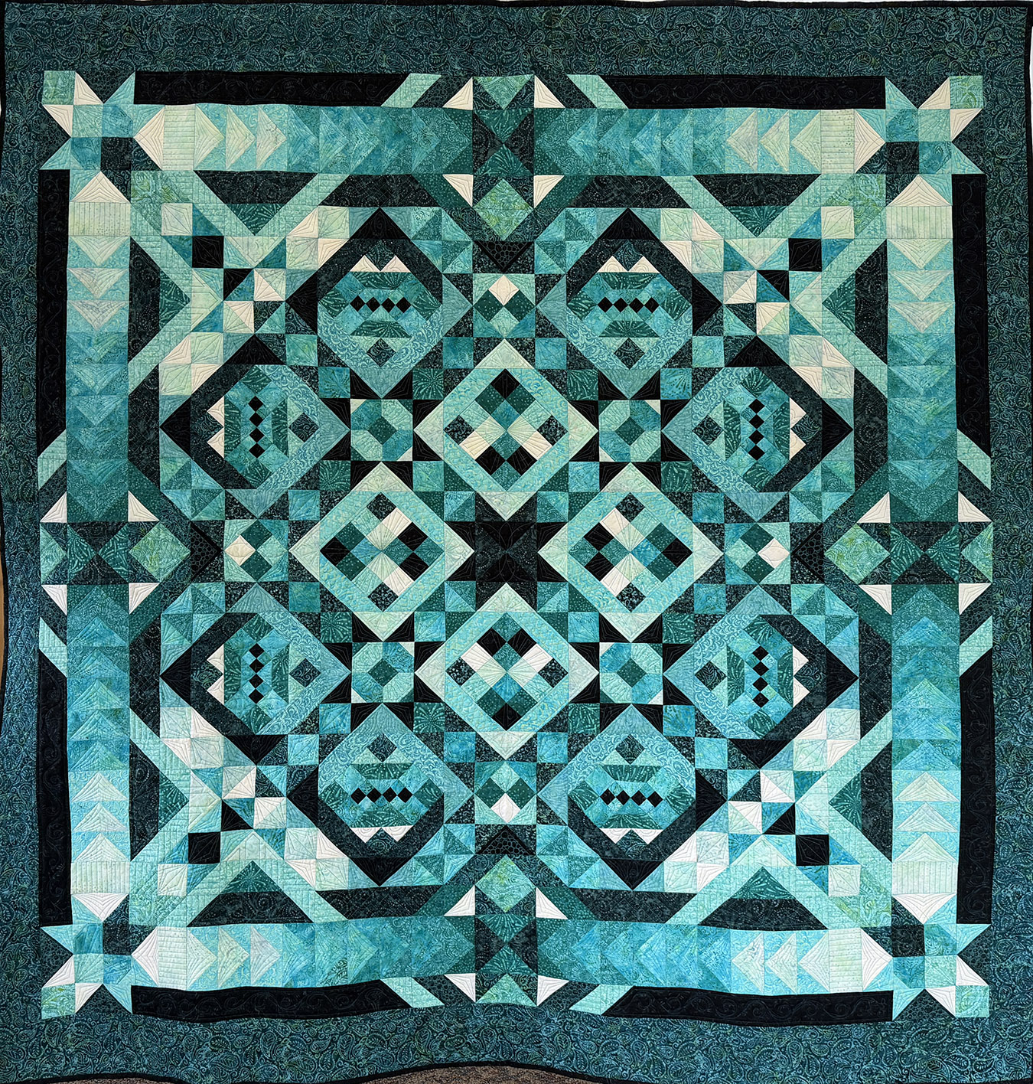
Pieced Solo - Bed
Teal-ing Good 2026
Lee Palmer

Slide 26
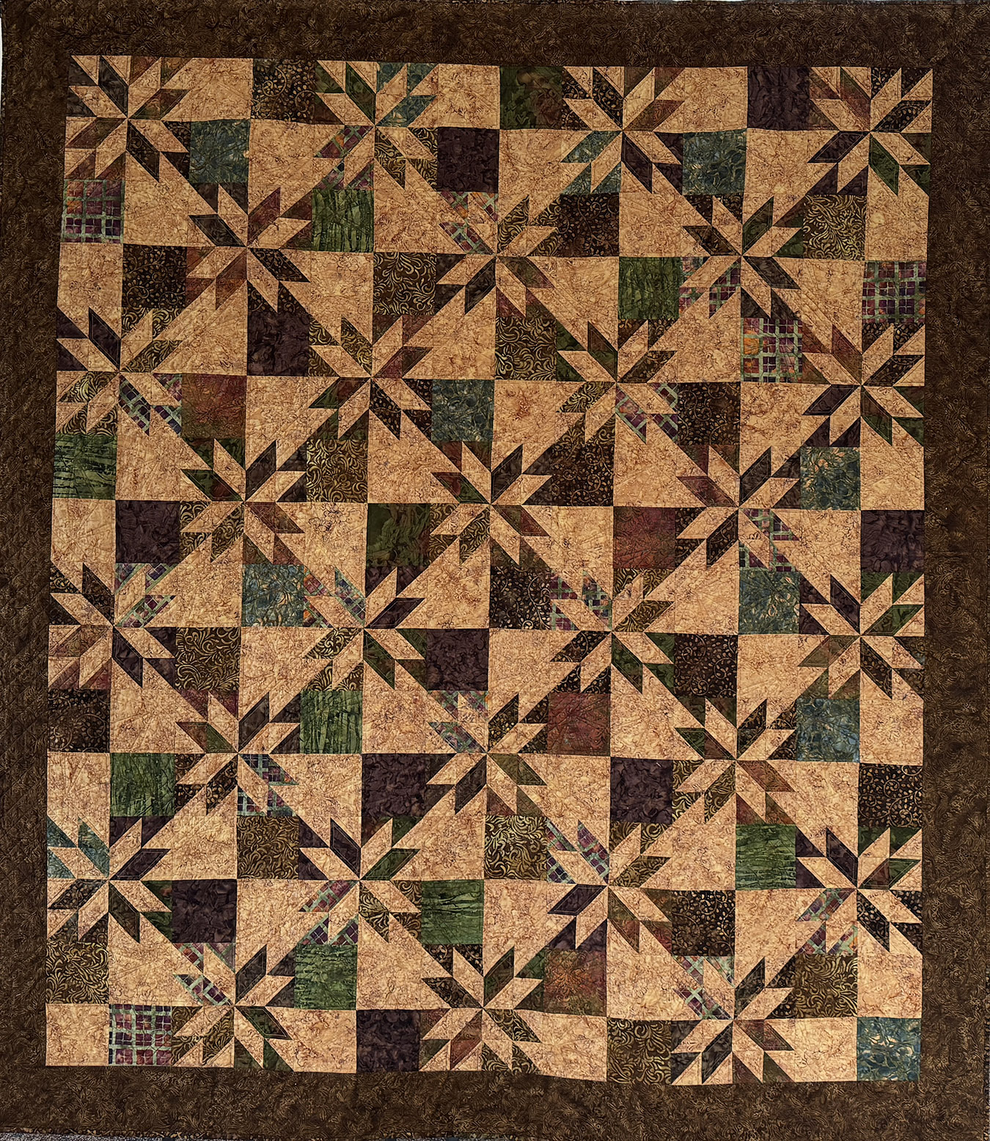
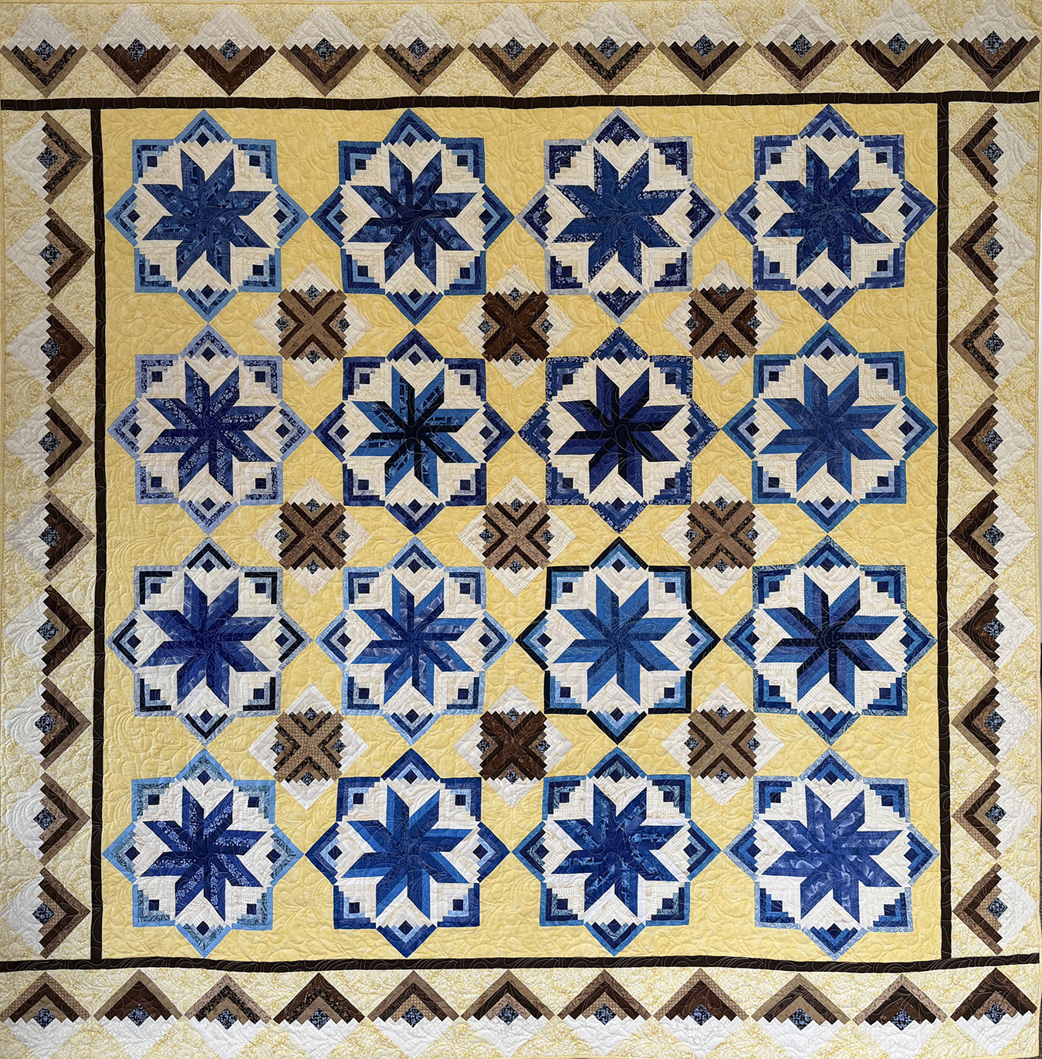
Pieced Solo – Bed 2nd
Pieced Solo – Bed 3rd
Eldon
Patricia Laub
Hunter’s Star
Patti Stephens
Pieced Solo – Bed HM
Tiny Bubbles
Paula Brown

Slide 27
Paper Pieced Large – 1st
Tula Pink in Pink
Cindy McEntee

Slide 28
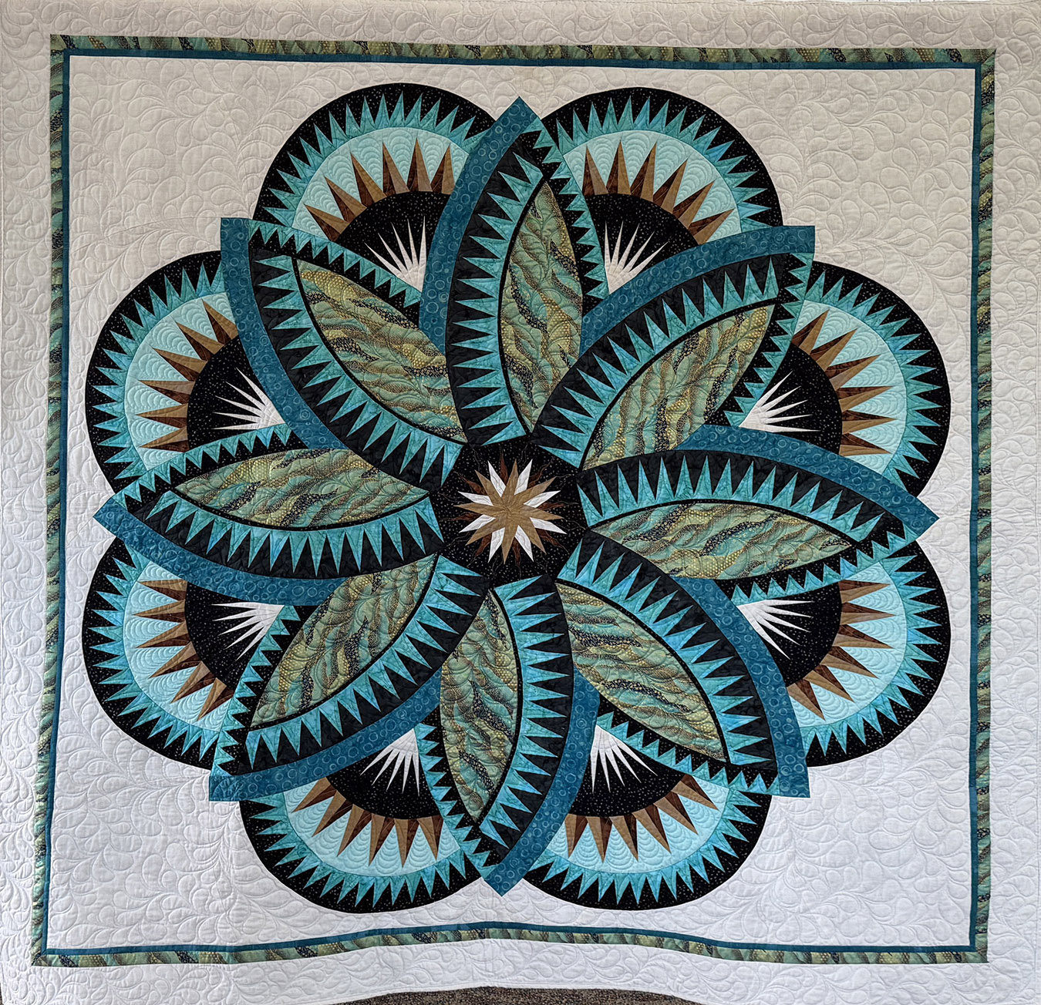
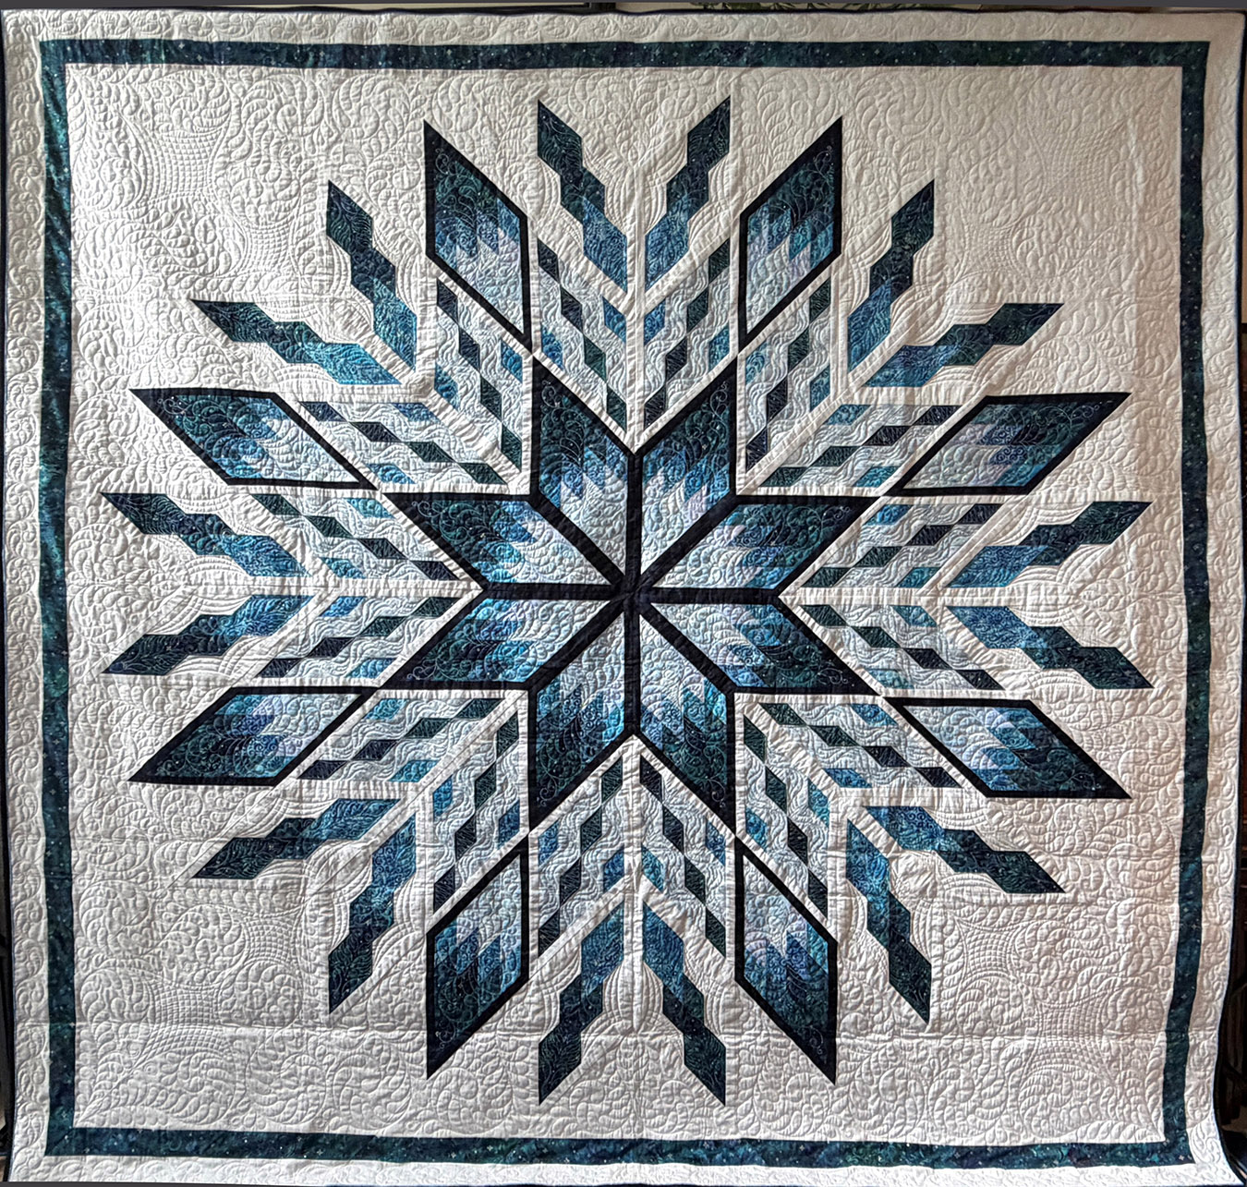
Paper Pieced Large - 2nd
Paper Pieced Large - 3rd
Happy Birthday Mom
Carrie Townsend
Polar Star
Nan Scott

Slide 29
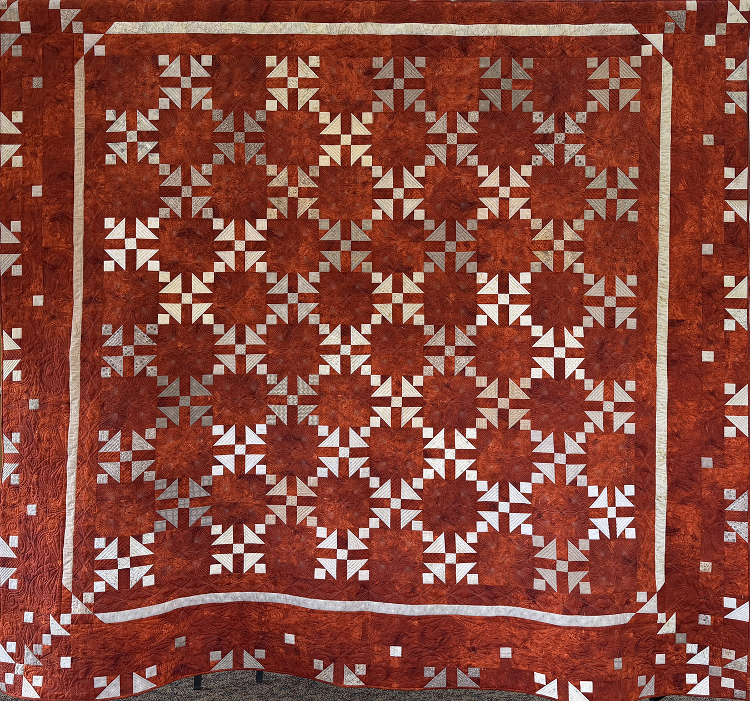
Pieced Ensemble Large
Bed 1st
Southwest Dreams
Susan Cronenwett

Slide 30
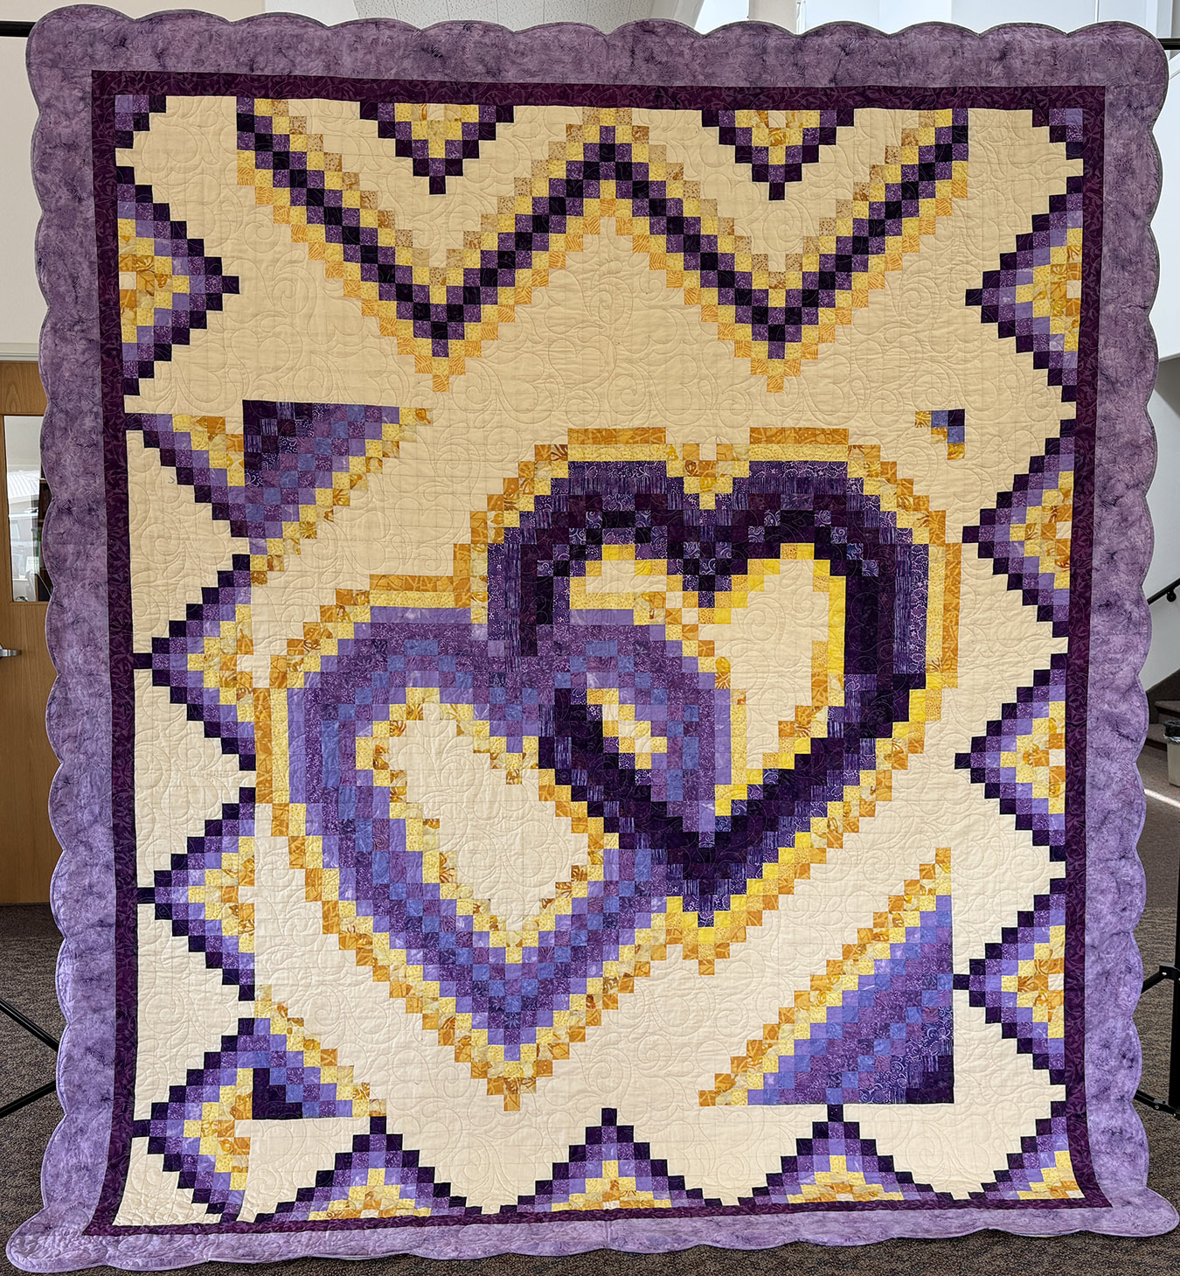
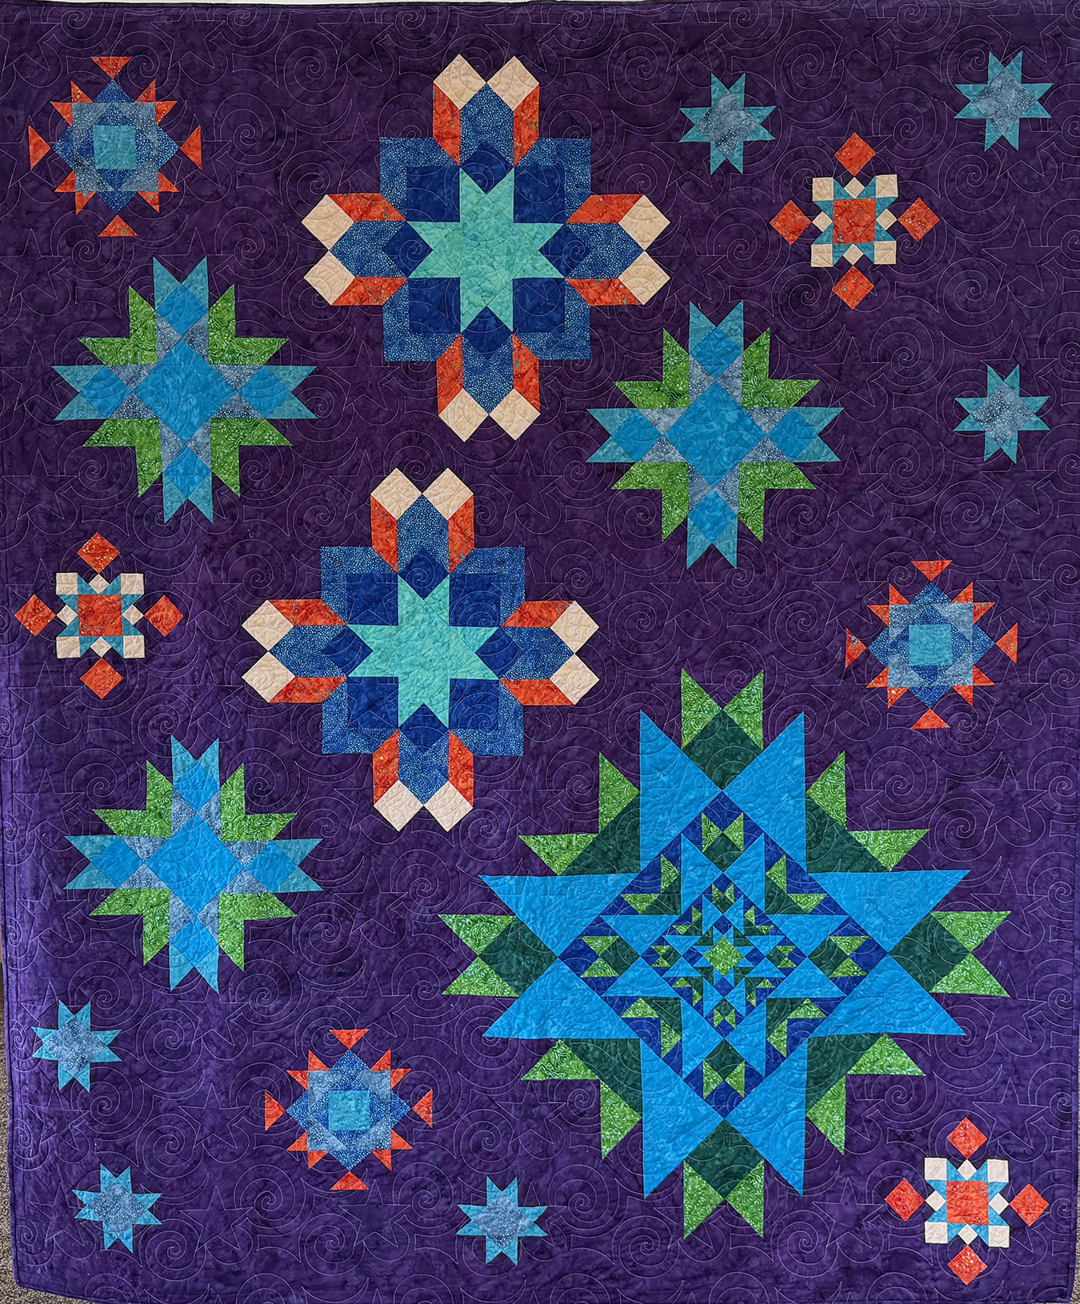
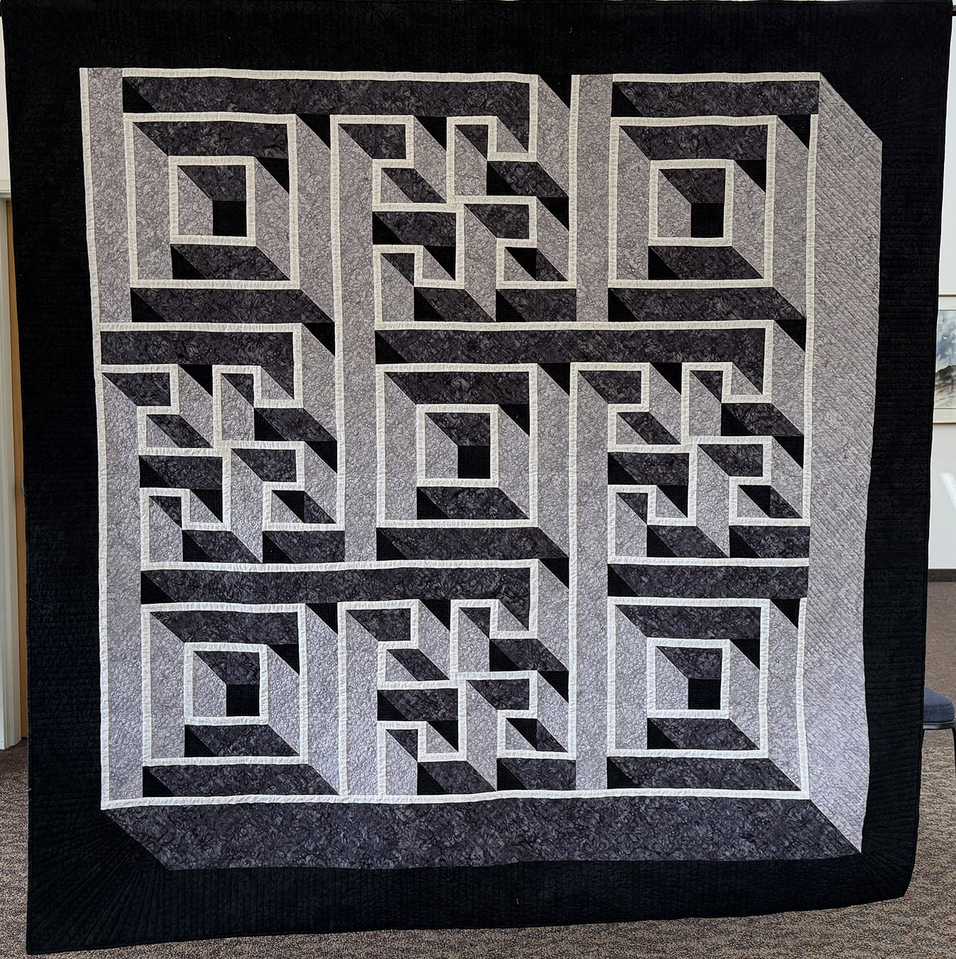
Pieced Ensemble Large – Bed 2nd
Pieced Ensemble Large – Bed 2nd
Mama Hugs
Darcy de la Rosa
Luminous Stars
Melanie Patterson
Pieced Ensemble Large – Bed HM
My Labyrinth Walk
Janet Sylveser

Slide 31
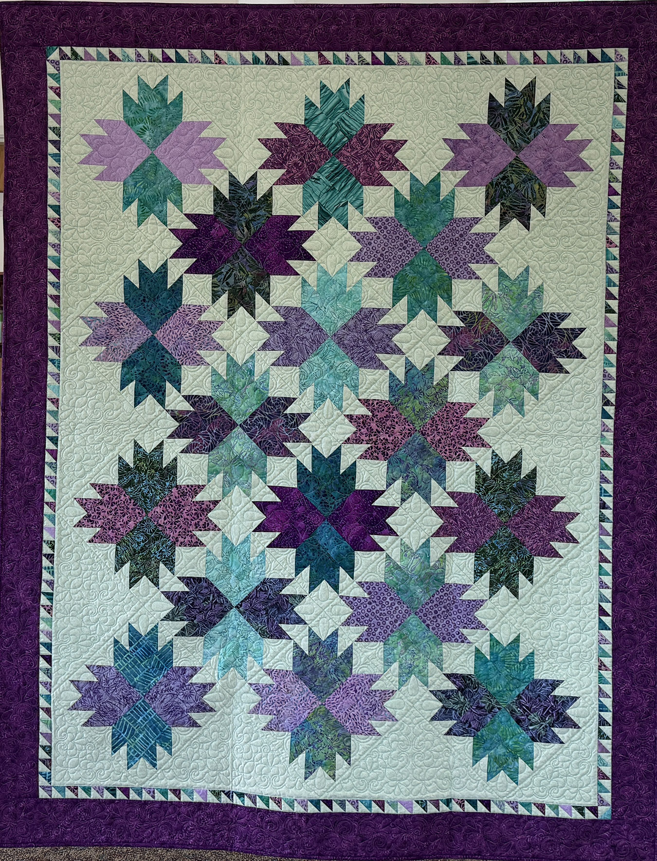
Pieced Ensemble Medium
Bed – 1st
Lilacs
Nancy Payne

Slide 32
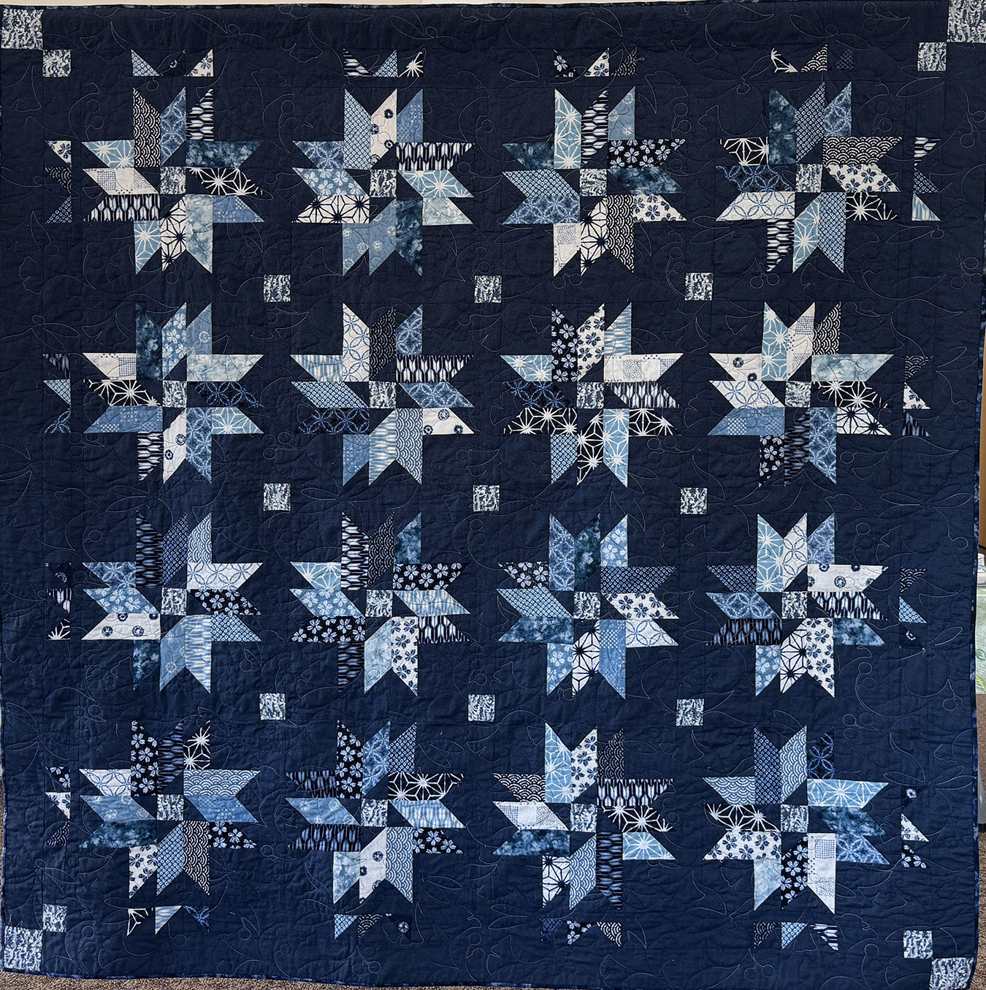
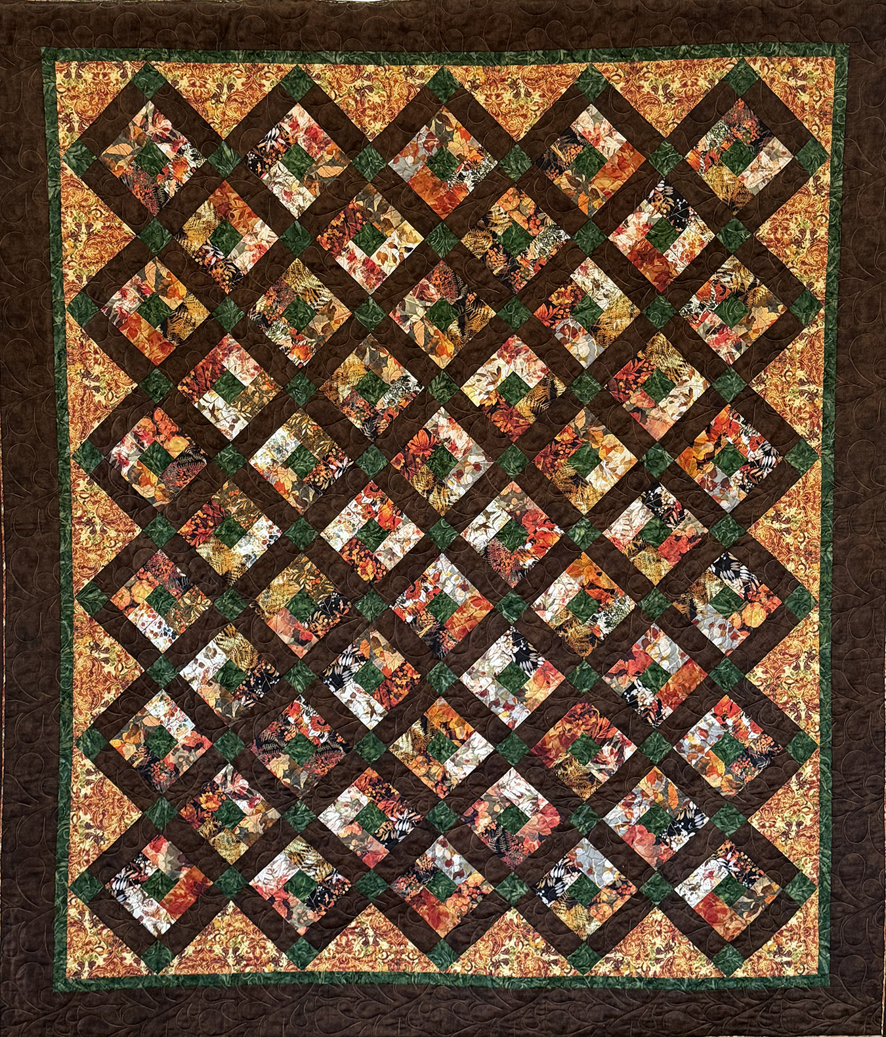
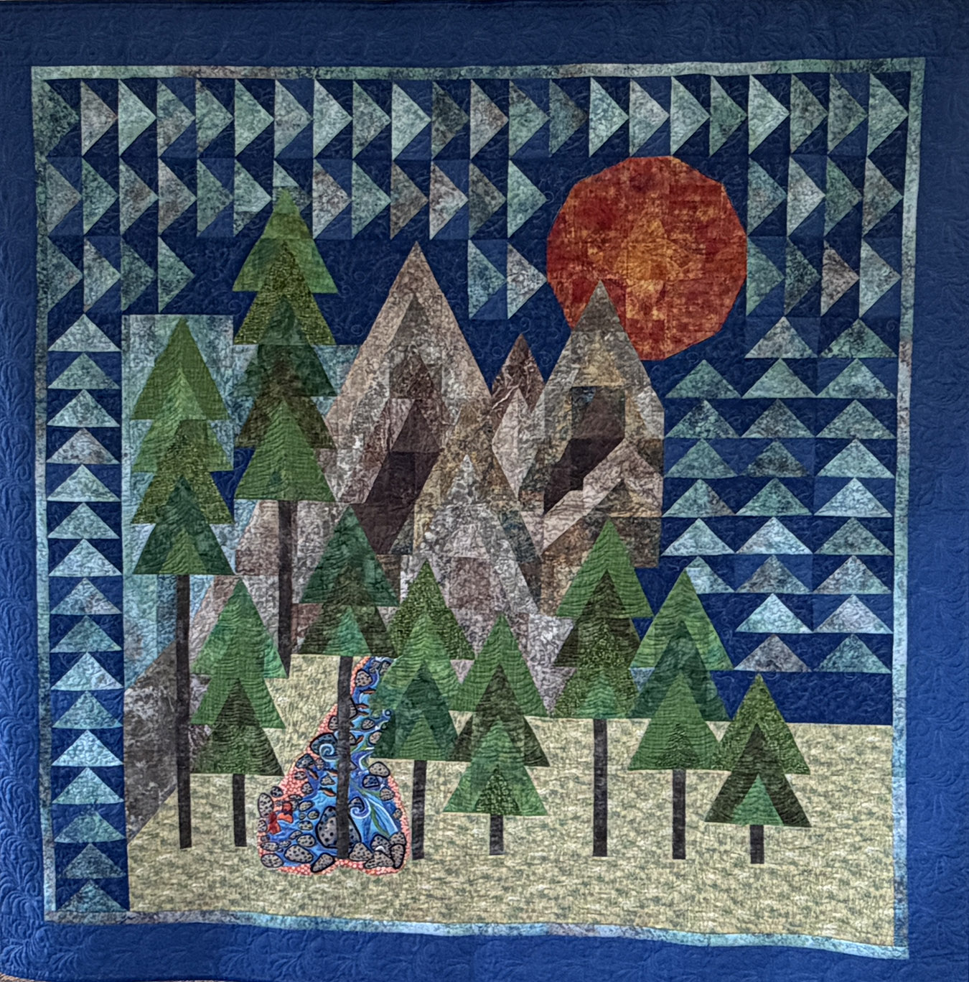
Pieced Ensemble Medium – Bed 2nd
Pieced Ensemble Medium – Bed 3rd
Shibori Stars
Jean Amundson
Pumpkin Spice Lattice
Melanie Patterson
Pieced Ensemble Medium – Bed HM
The Mountains are Calling
Ruth Hutmacher

Slide 33
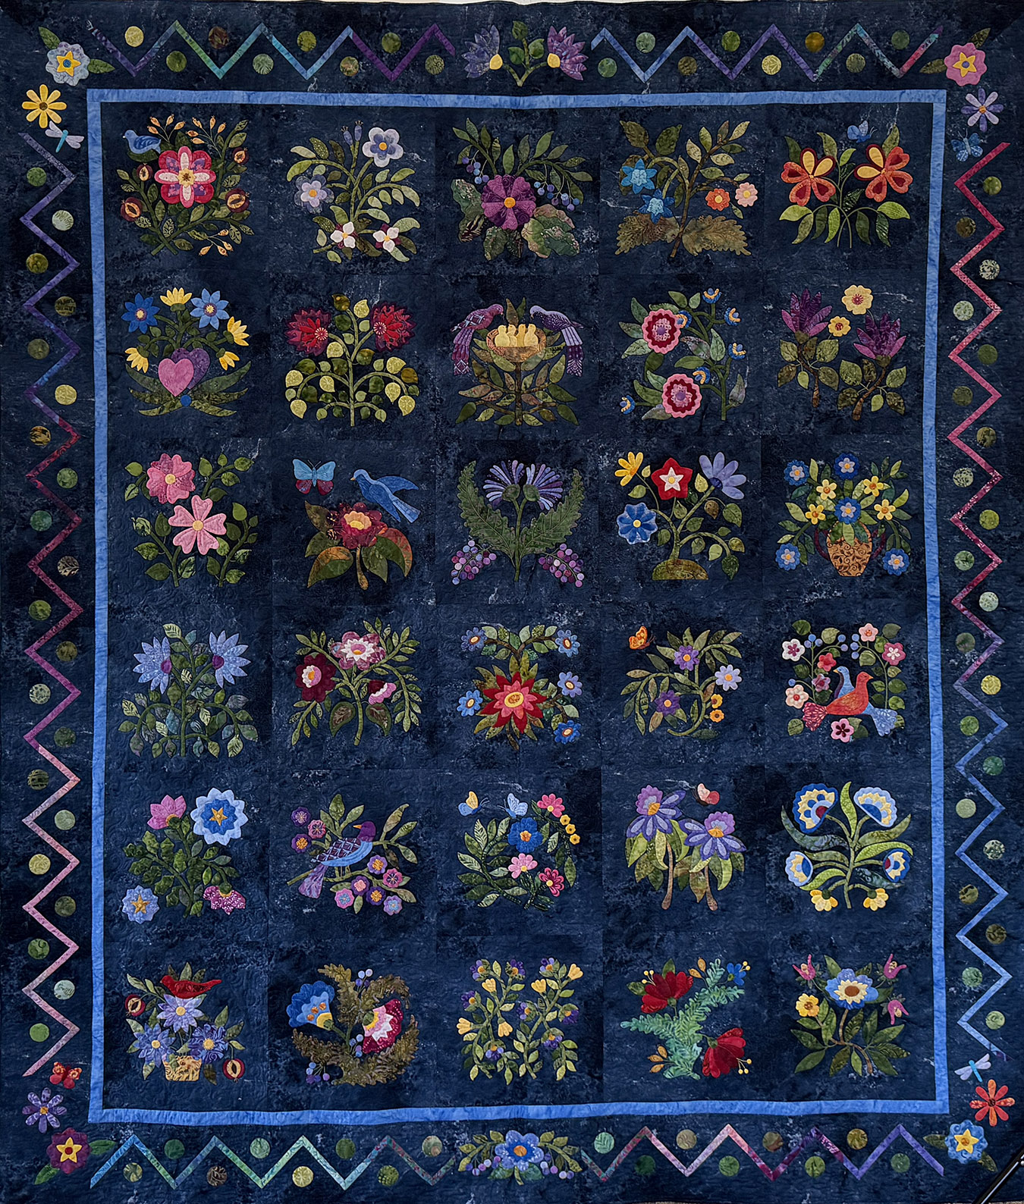
Appliqued – Bed 1st
Caswell
Julia Bailey

Slide 34
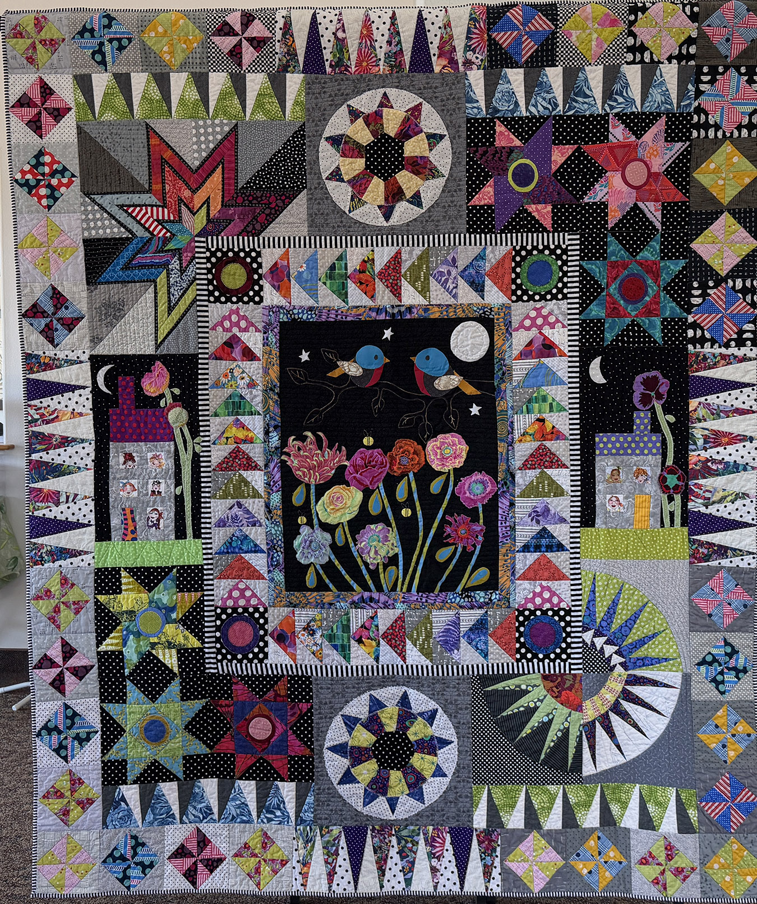
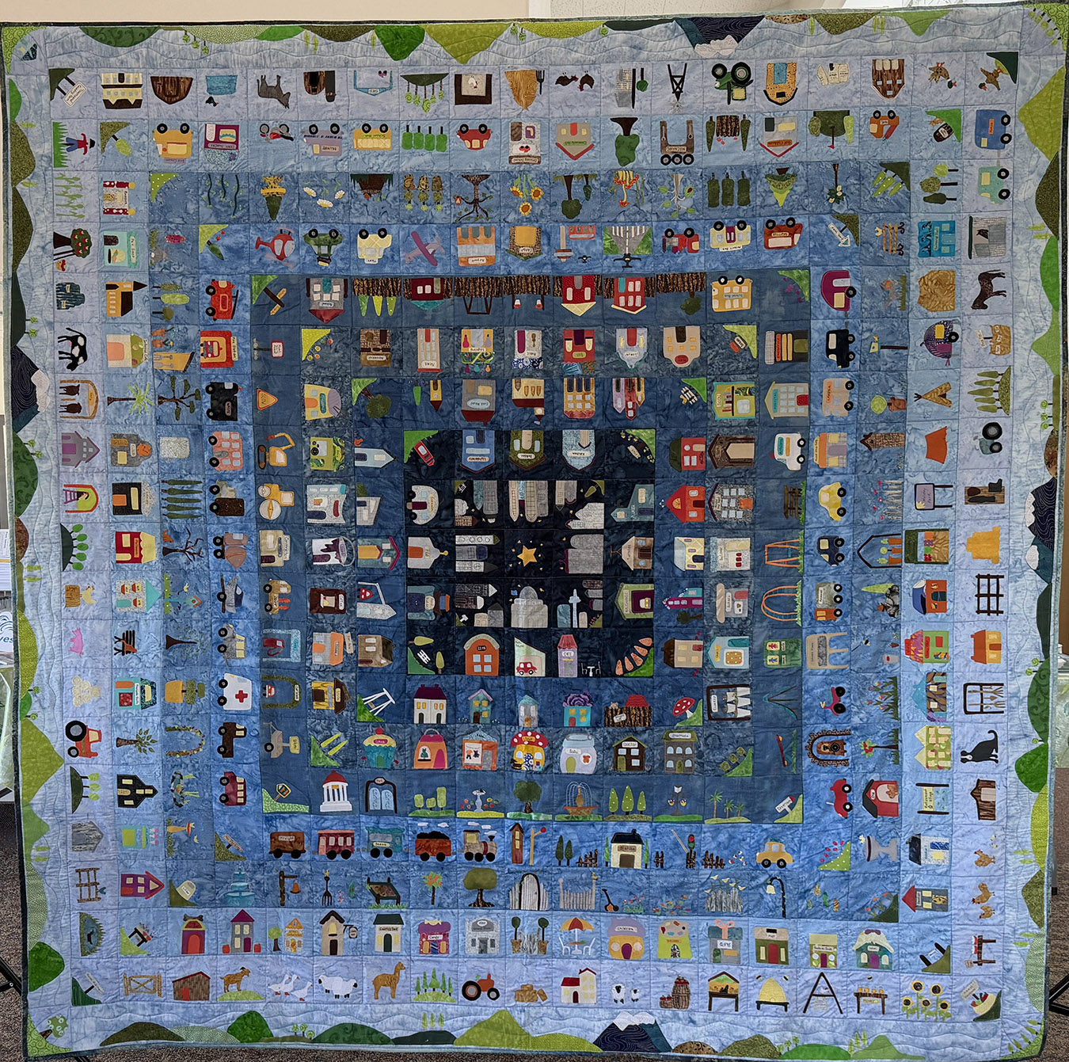
Appliqued – Bed - 2nd
Appliqued – Bed - 3rd
Town and Country
Carrie Townsend
Missing Owls
Penni Myers

